Slide 1
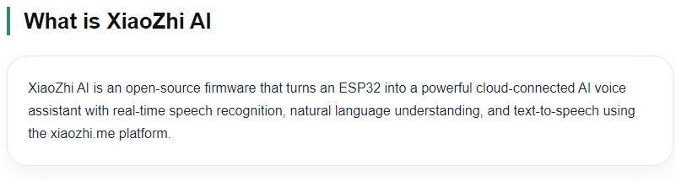
XiaoZhi AI Chatbot

Slide 2
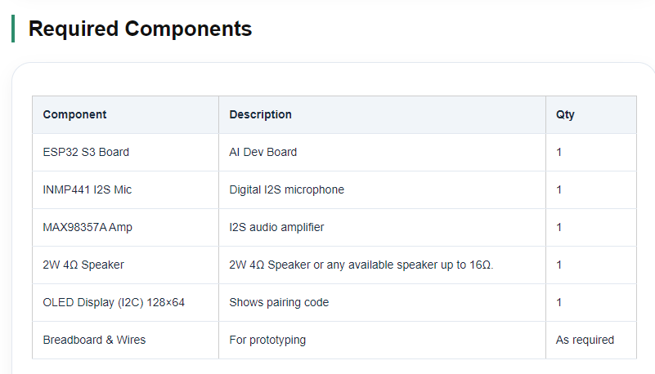

Slide 3
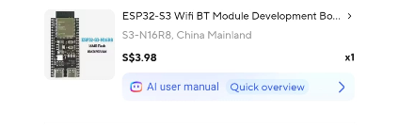
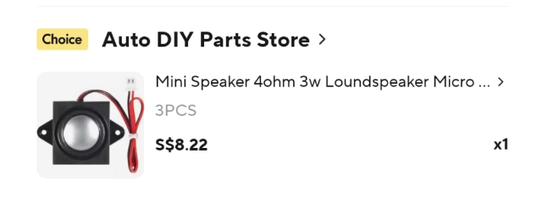
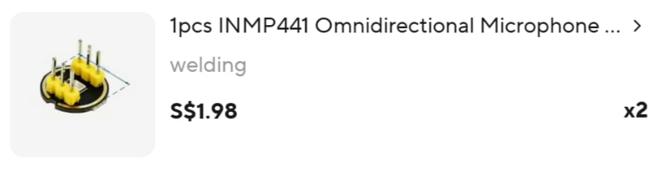
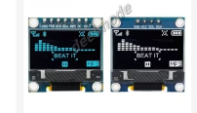
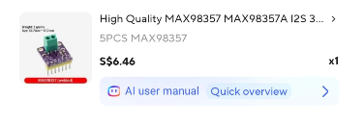
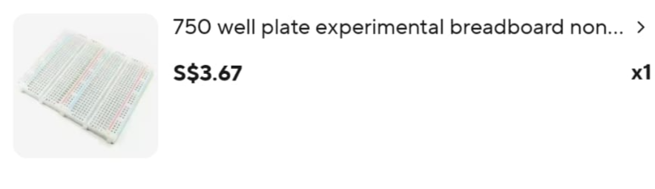
Bills of material – sourced from AliExpress
If you are not great in soldering like me
I suggest you buy the more expensive
Welded version which cost slightly more
Found in NLBStarterkit

Slide 4
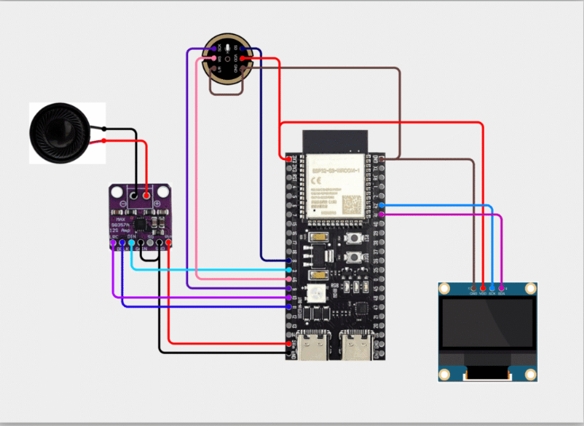
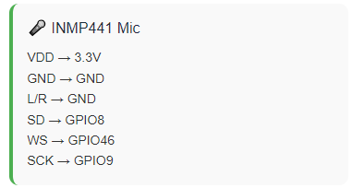
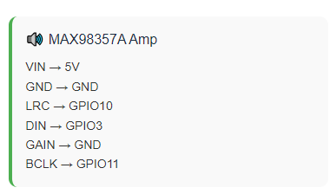
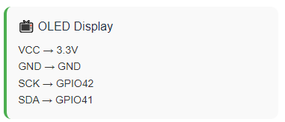
ESP32 Pins

Slide 5

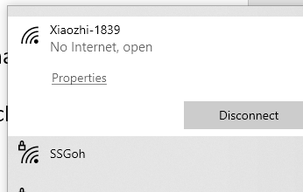
Go to this link
AI Xiaozhi - OceanLabz
https://www.oceanlabz.in/category/ai/ai-xiaoxhi/
RST
Restart the Chatbot
Follow the instructions on this page to set up
this chat bot. It’s self explanatory
After the Connection is completed
You will hear Enter Wifi Configuration mode
If not, press the Boot button
Boot
Interrupt the chatbot
After flashing, the ESP32 creates a hotspot named Xiaozhi-XXXX.

